Slide 1

Web Development 1
Lecture 6a
Styling lists (ready for navbars…)

Slide 2
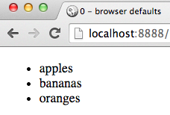
Default styling for unordered lists
Bullet points
Margin/spacing on the LEFT of the list (making space for the bullets)
<ul> <li>apples</li> <li>bananas</li> <li>oranges</li> </ul>
HMTL

Slide 3
Motivation: navbars are LISTs of LINKS
We don’t always want a LIST to look like a list
Navbars are LISTs of LINKS
But we don’t usually want BULLET points in navbar
We don’t usually want left-indent or top margins for navbars
So let’s learn how to:
Change / remove bullets points / numbering from lists
Remove all spacing around lists

Slide 4
remove list item ‘bullets’

Slide 5
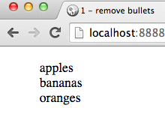
How remove bullet markers for list items?
CSS property list-style-type controls type of list and marker (numbered / discs / squares etc.)
list-style-type: none
Almost all browsers underline links by default
Let’s turn off bullets for ALL unordered lists:
ul {
list-style-type: none;
}
CSS

Slide 6
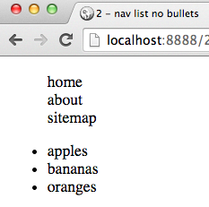
ALL unordered lists??? only remove bullets for lists in NAV
<nav> <ul>
<li>home</li>
<li>about</li>
<li>sitemap</li> </ul>
</nav>
<ul>
<li>apples</li>
<li>bananas</li>
<li>oranges</li> </ul>
HMTL
/* descendent selector – target UL in NAV */
nav ul {
list-style-type: none;
}
CSS

Slide 7
remove list spacing

Slide 8
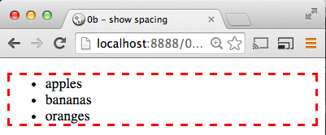
Default styling for unordered lists adds padding and margin around list block
Adding a border lets us see margin/padding
ul { border: 0.2rem dashed red; }
CSS
Margin – outside border
Padding – inside border

Slide 9
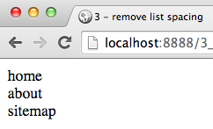
Remove padding and margin
nav ul { list-style-type: none; margin: 0; padding: 0; }
CSS

Slide 10
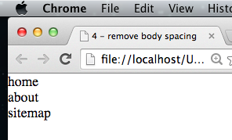
Body has margin/padding too
Note
The white space around list is now just the margin/padding applied to BODY by browser
Can remove that too
But don’t have text right up a border hard to read …
body { margin: 0; padding: 0; }
CSS

Slide 11
Summary and Conclusions

Slide 12
Navbar list of link styling
Remove LIST ‘bullets’
list-style-type: none;
remove margins/padding
margin: 0; padding: 0;
(remember to use descendent selector nav ul so only lists in nav elements are being styled ...)

